Slide 1


Welcome to Bharat Tex 2025

Slide 2

BHARAT TEX 2024
A PHENOMENAL SUCCESS
2

Slide 3
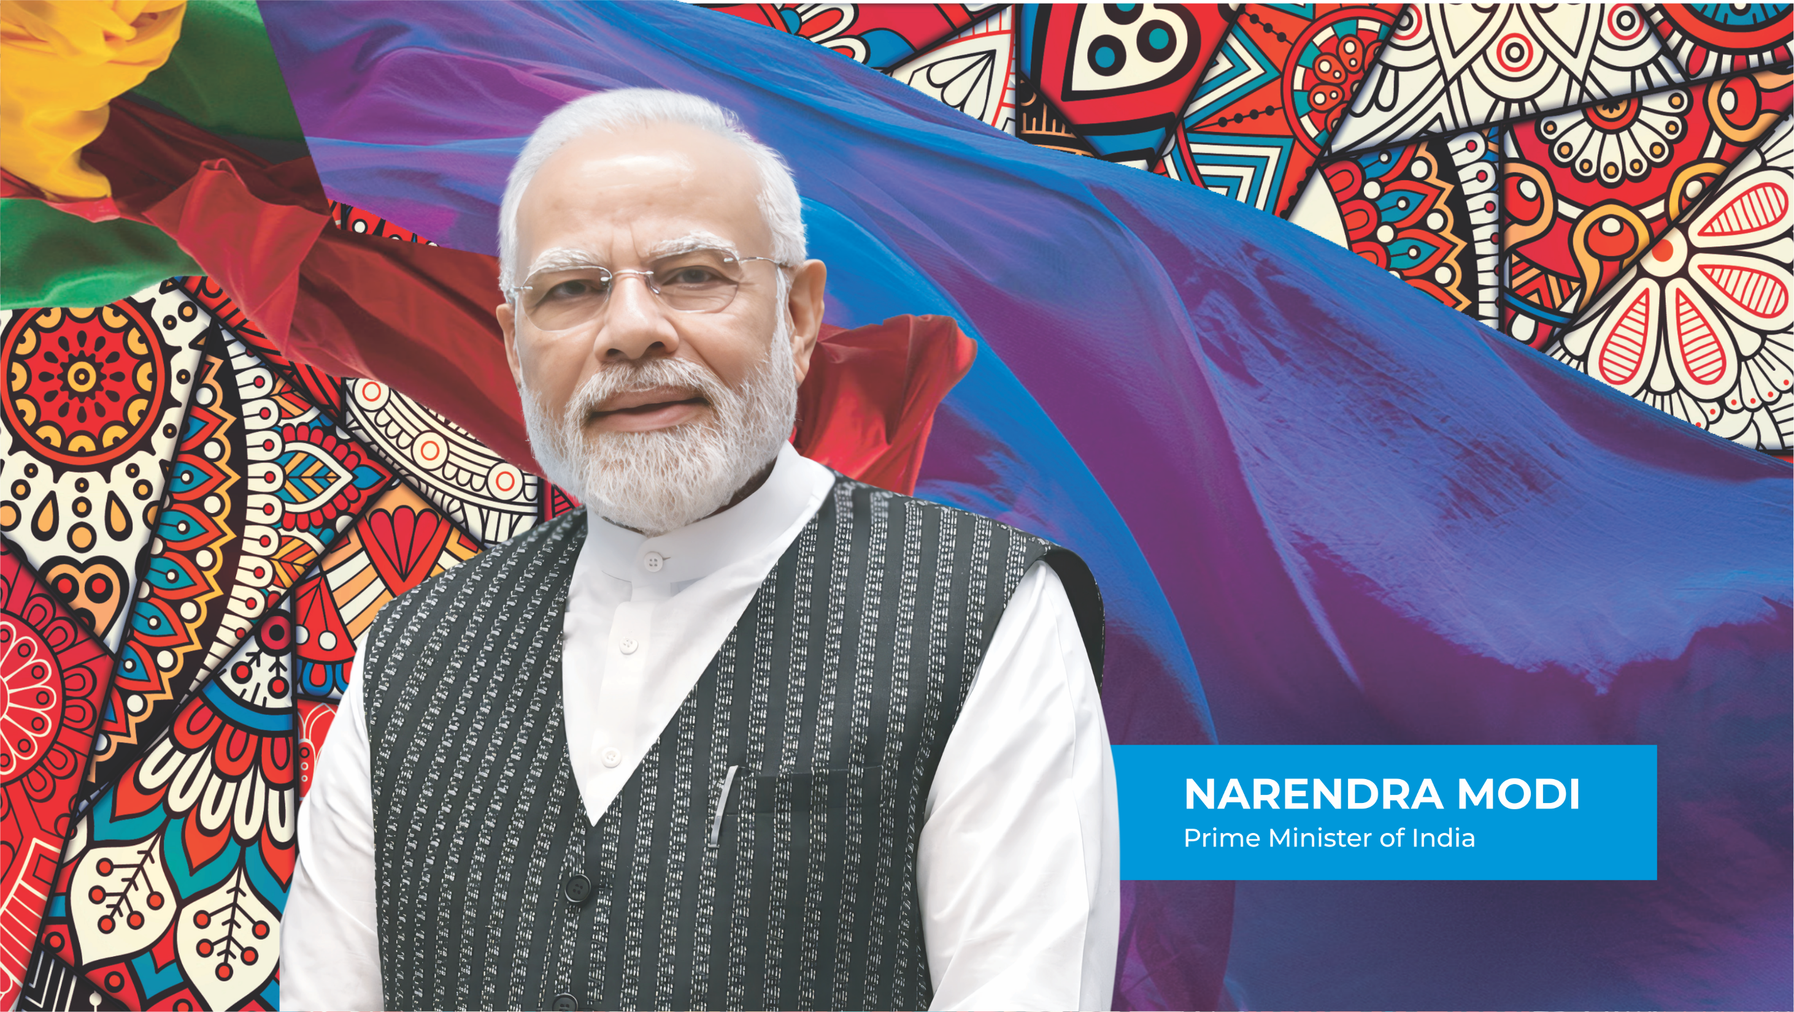

3

Slide 4
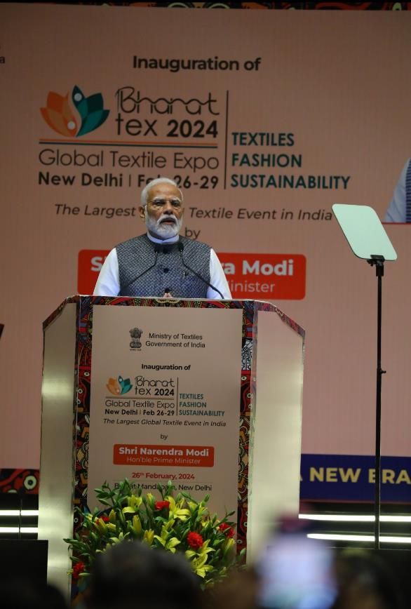
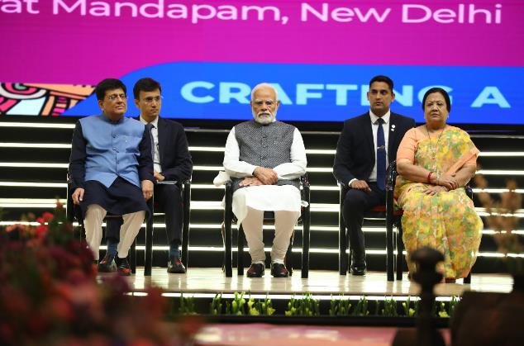
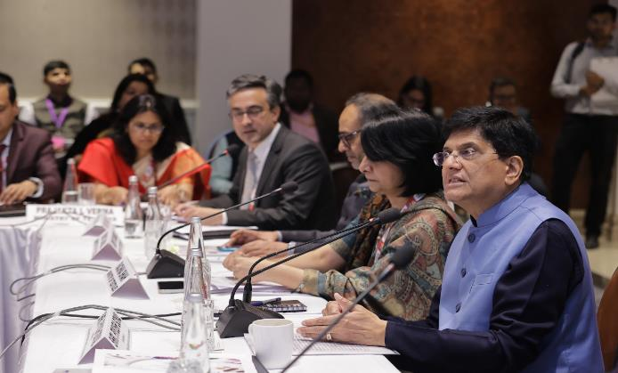
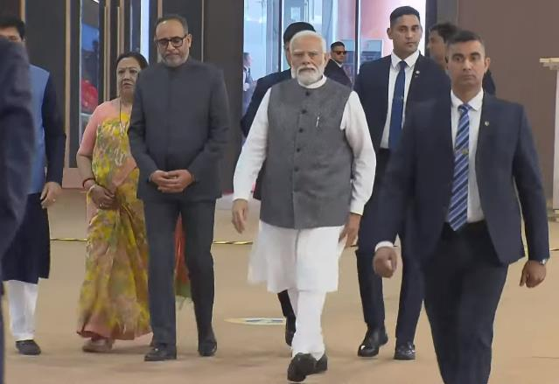
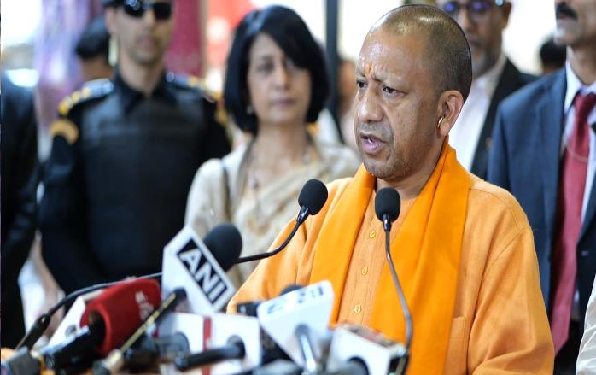
INAUGURATION BY THE HON’BLE PRIME MINISTER OF INDIA
4

Slide 5

BHARAT TEX 2024 - BRINGING THE WORLD TO INDIA
Unified 5F focus
Covered the entire value chain from fibre to finished products under one roof
50+ Knowledge Sessions, 112 International Speakers
3 CXOs Roundtables
45 High-Octane Panel Discussions
01
04
Largest ever exhibition area
2 mill sq ft. exhibition space
2 parallel venues
02
63 MoUs, 8 Book Launches
Launch of IndiaTEX
ESG fora, Gender talks, films
05
03
06
Global in Size and Reach
~3,000 Buyers from 110+ Countries
1,00,000 visitors
5 Fashion Presentations
Dedicated Sectoral Events
International Silk Conference NIFT Alumni meet, Indi Haat, etc.
One-of-a-kind Global Mega Textile Event

Slide 6
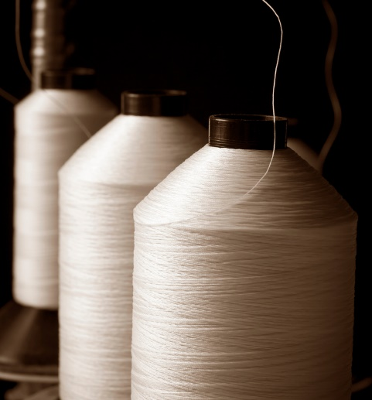

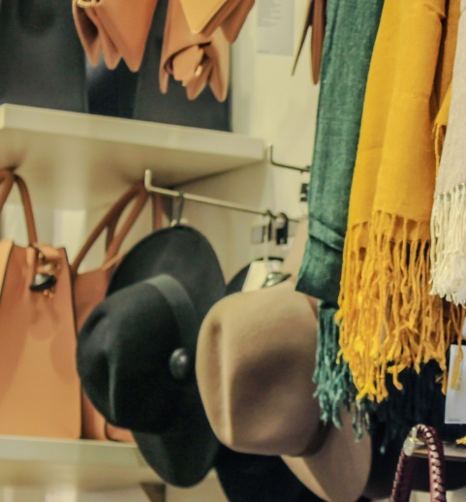

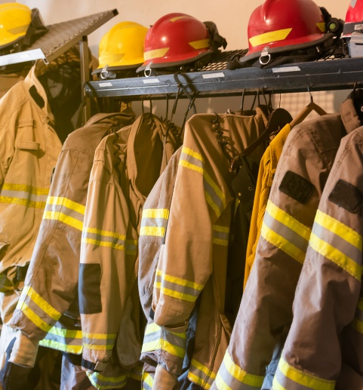
A GLOBAL TRADE EXPO – SIZE, SCOPE AND DIVERSITY
3,500+
3,000+
30,000+
1,00,000+
EXHIBITORS
OVERSEAS
BUYERS
DOMESTIC
BUYERS
VISITORS
YARNS &
FIBRES
FABRICS &
TRIMS
APPARELS &
FASHION
HOME TEXTILES
TECHNICAL TEXTILES

Slide 7


























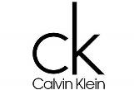












A TRULY GLOBAL EVENT - 110 COUNTRIES PARTICIPATED
Major Participating countries
USA
UK
Switzerland
Australia
Japan
Netherlands
France
Portugal
Austria
Denmark
Hong Kong
Mauritius
Sweden
Estonia
Singapore
Germany
Spain
Italy
South Korea
Bangladesh
UAE
Canada
China
Kenya
Major Participating Brands
Coach
Tommy Hilfiger
Calvin Klein
Vero Moda
Jack n Jones
JCPenney
H&M
Target
…and many other leading brands and companies
Kohl’s
Kmart
Lenzing
Anko
Busana Group
Brandix
Cotton Connect
7

Slide 8
Building on success of
Bharat Tex 2024
India’s Global Textile Fair
Bharat Tex
returns
8

Slide 9
www.bharat-tex.com
9

Slide 10
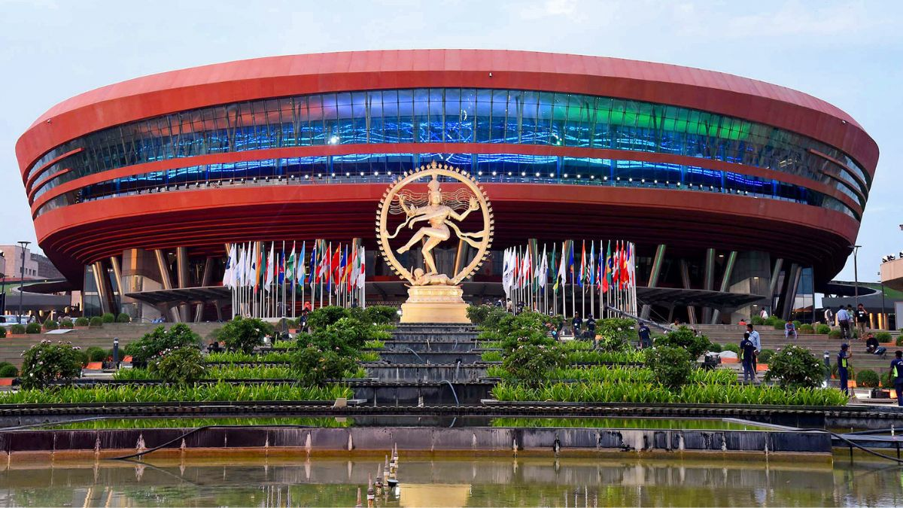
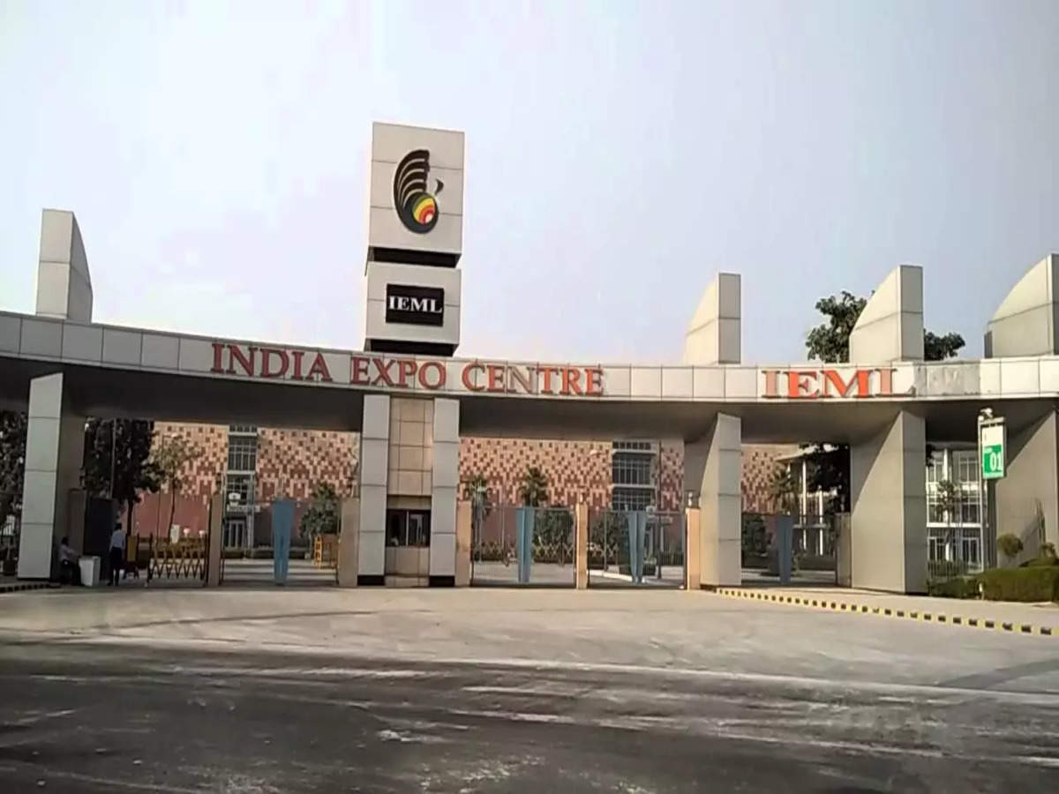
HOSTED AT 2 STATE-OF-THE-ART VENUES
14-17th February 2025
12-15th February 2025
Bharat Mandapam | New Delhi, India
Main Event
The Complete Textile Value Chain Exhibited
India Expo Centre & Mart | Greater Noida, India
Focus Areas: Handicrafts, Apparel Machinery, Chemicals & Dyes
10

Slide 11

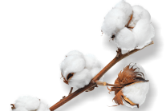



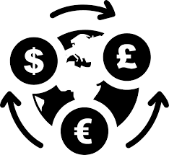

BHARAT TEX 2025 – A GLOBAL TRADE EXPO
A GLOBAL SIZED TRADE FAIR
5,000+ Exhibitors
6,000+ International Buyers
12,000+ Textile Products
2,20,000+
Sq. ft Area
1,20,000+ Visitors

Slide 12

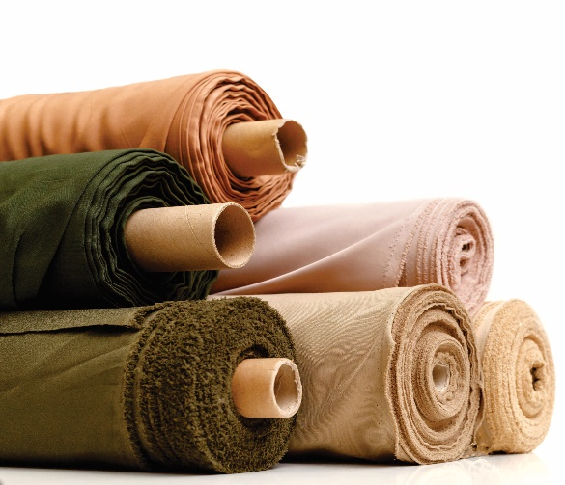


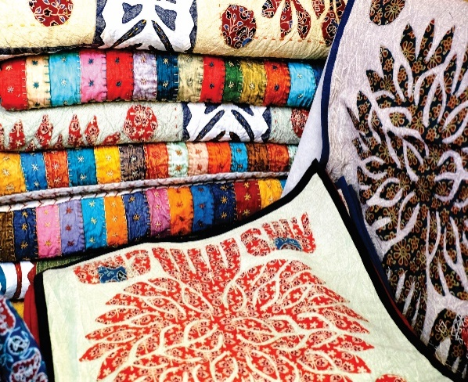
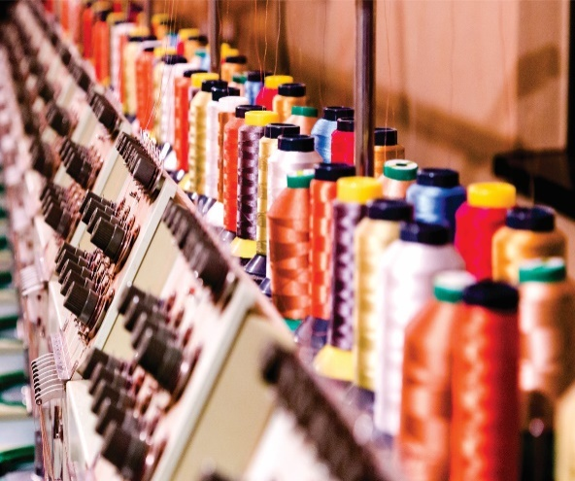
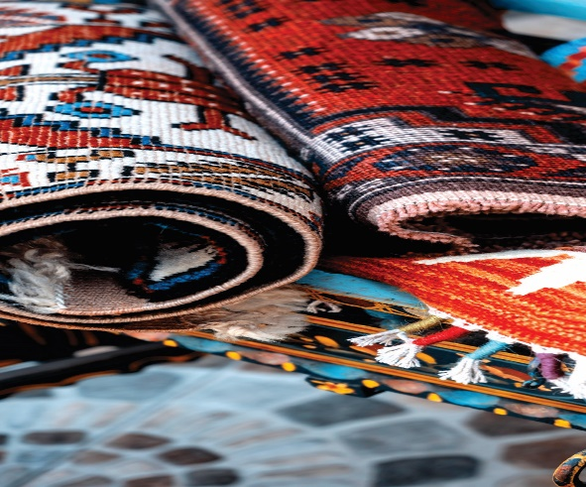
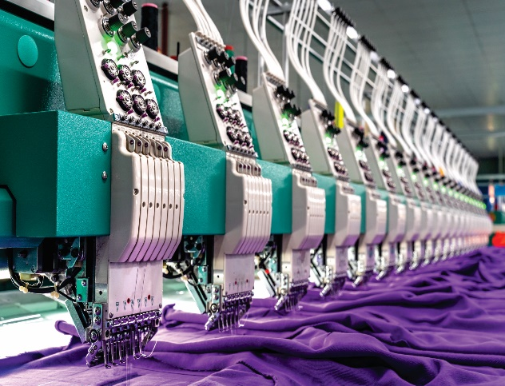
FROM FARM TO FIBRE TO FASHION - UNIFIED & DIVERSE
FIBRES & YARNS
FABRICS
APPAREL & FASHION
HOME TEXTILES
HANDLOOMS
TECHNICAL TEXTILES
HANDICRAFTS & CARPETS
INTELLIGENT MANUFACTURING

Slide 13
A GLOBAL TEXTILE DIALOGUE
60+ High Octane
Sessions
Roundtables
Global Leadership and policymakers
Global stakeholders
Master Classes
Curated Textile Tours
Sustainability
Global Mega Trends
Trade and Investment
Conference and Knowledge Sessions
Country Policies
Investment Seminars
MoU Signings
Product Launches
Technical Sessions
Themes
Industry 4.0
Trade and Investment
ESG and Sustainability
Global supply Chains
Fashion, trends and Design

Slide 14
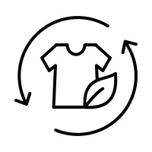



SUSTAINABILITY IS THE BEATING HEART OF BHARAT TEX
Sustainability
Pavilions
Global Sustainability
Dialogue
Sustainable
Materials
Innovations
and Start Ups
Pavilions on Sustainability and Circularity
Sustainable Solutions Showcase
Case Studies
Dedicated Ideation sessions
Closed Loop Manufacturing
Textiles Waste Management
Green Value Chain
Eco-friendly and alternative raw-materials
Scalable sustainable innovations
Textiles Grand Innovation Challenge
Showcase of Sustainability Start ups

Slide 15






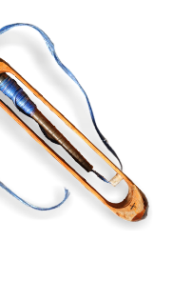
A FESTIVAL OF TEXTILES
Immersive Material Testing Spaces
Cultural Performances & Fashion Presentations
Trend Forecasts from Industry Experts
Textile Art Installations
Best of Traditions & Technology
Product Launches with Renowned Designers

Slide 16




THE DESTINATION OF CHOICE FOR THE TEXTILE INDUSTRY
A Global scale trade fair
The only event in the entire world to feature the entire value chain - Fibre, Yarn, Fabrics, Apparel, Home Textiles, Handicrafts, Handlooms, Carpets, Technical Textiles, Machinery, Chemicals and Dyes etc.
A Global textile dialouge
Over 60 Knowledge Sessions focusing on Global Mega Trends, Sustainability, Industry 4.0 etc.; Meetings with Global and Indian industry leaders, Policymakers and thought leaders
UNPARALLELED Networking opportunities
Networking opportunities spread across 4 days with key Global Brands/Retailers, Domestic Industry captains, Buyers, Suppliers, Machinery Manufacturers, etc.,
A Mega celebration of textiles and technology
Immersive experiences through fabric testing zones, trend forecasts, fashion presentations, innovation pavilions, master classes, interactions with universities and fashion institutes

Slide 17
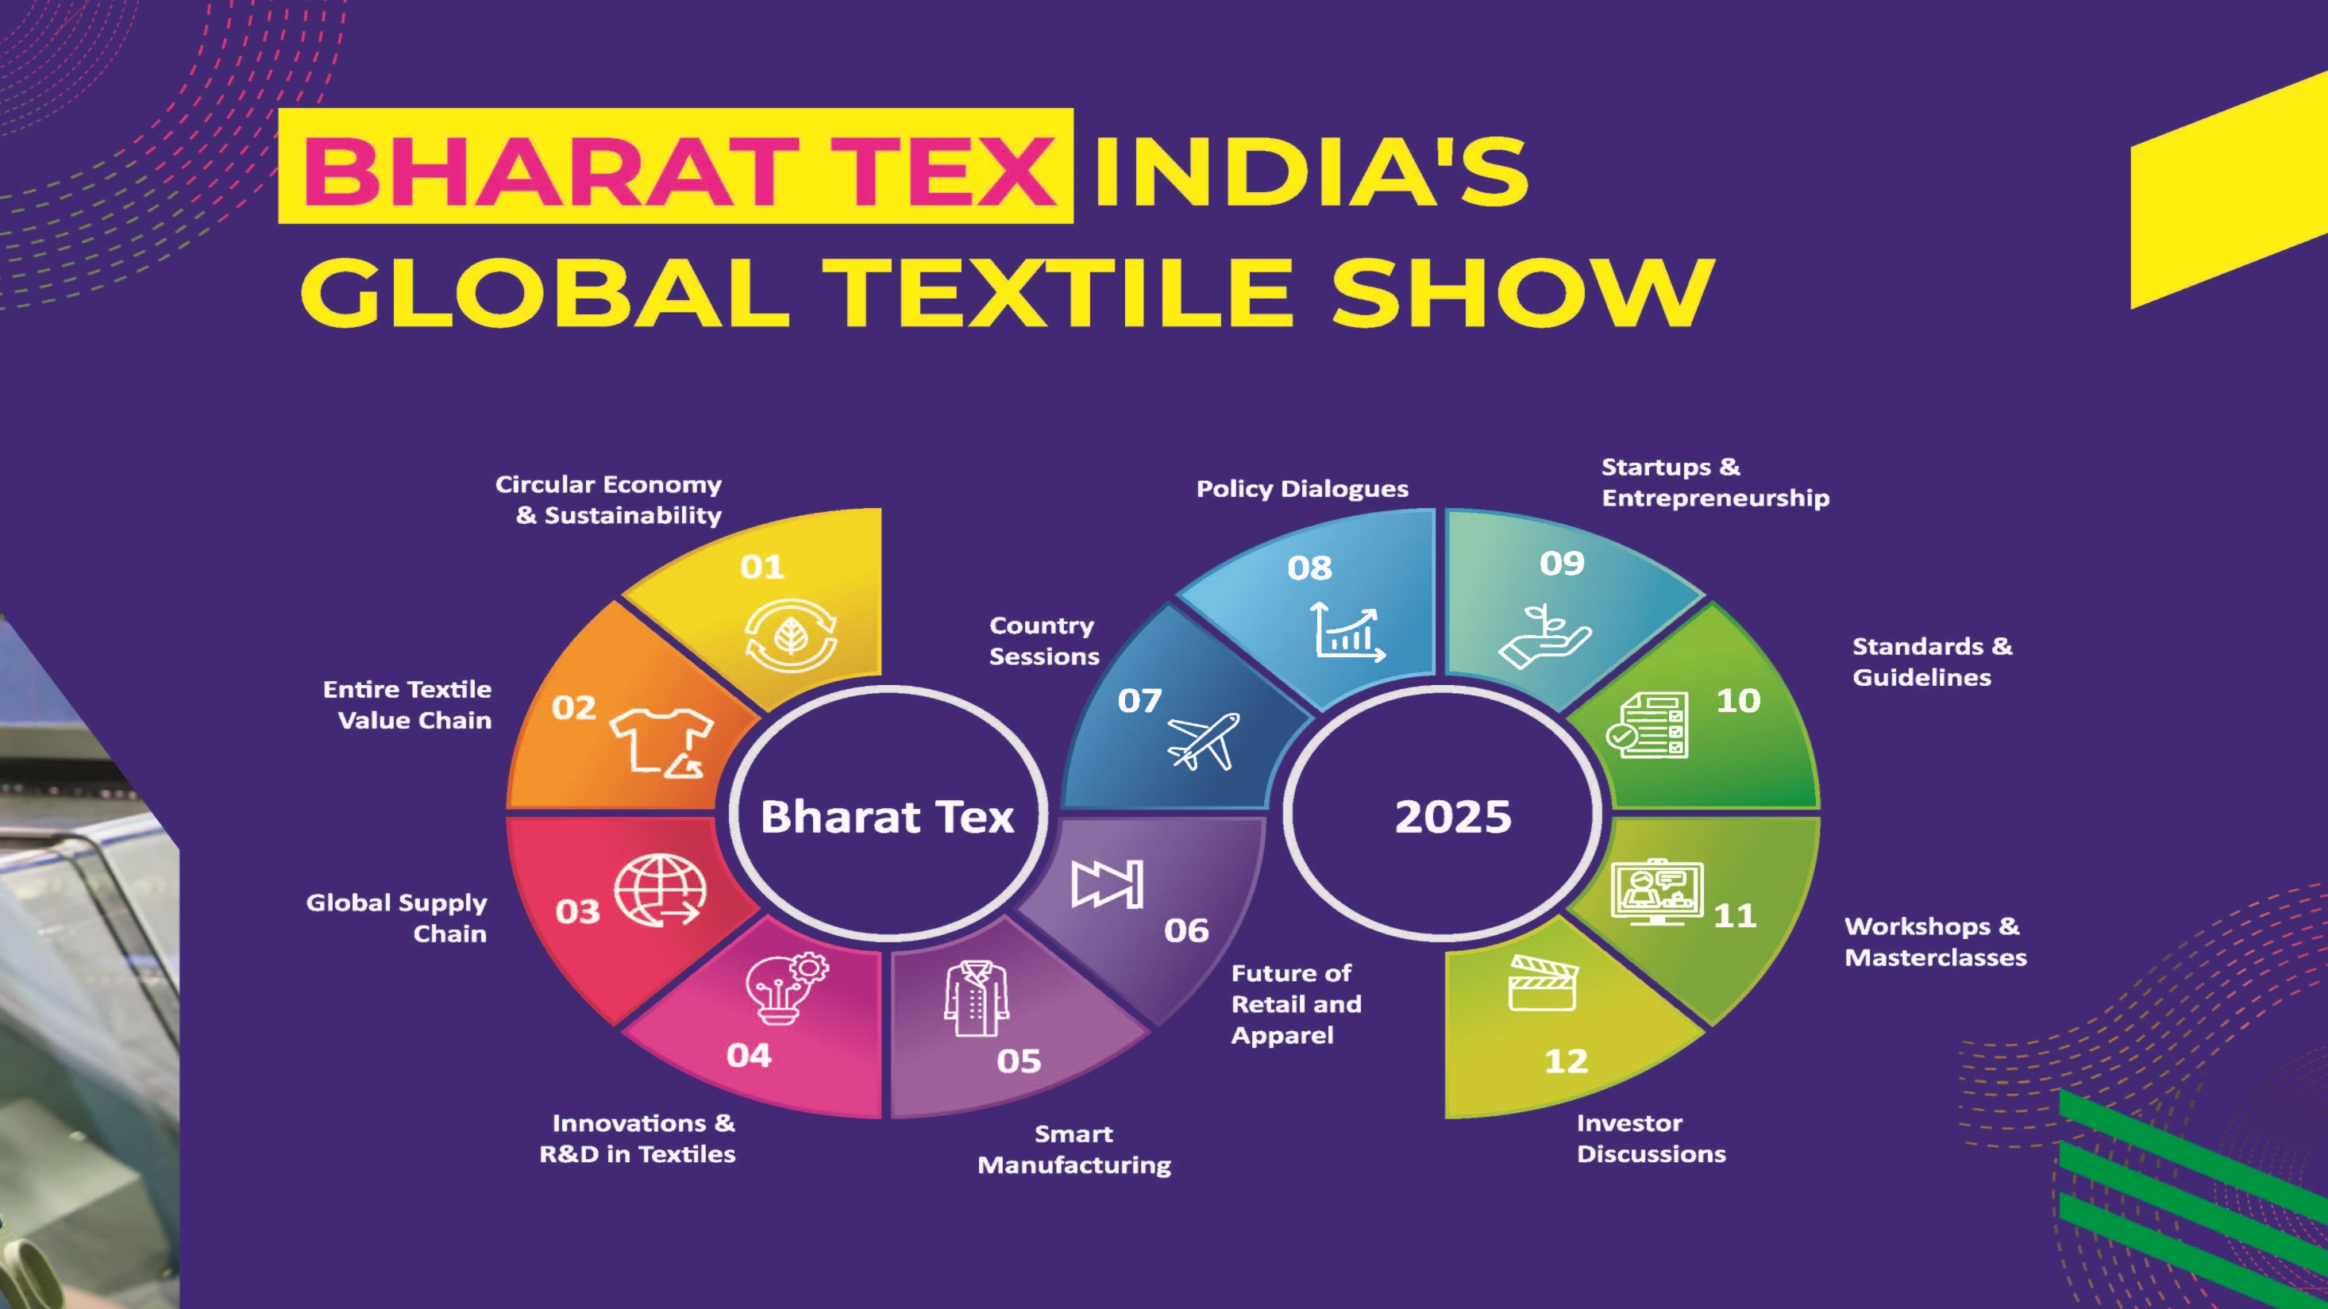
17

Slide 18
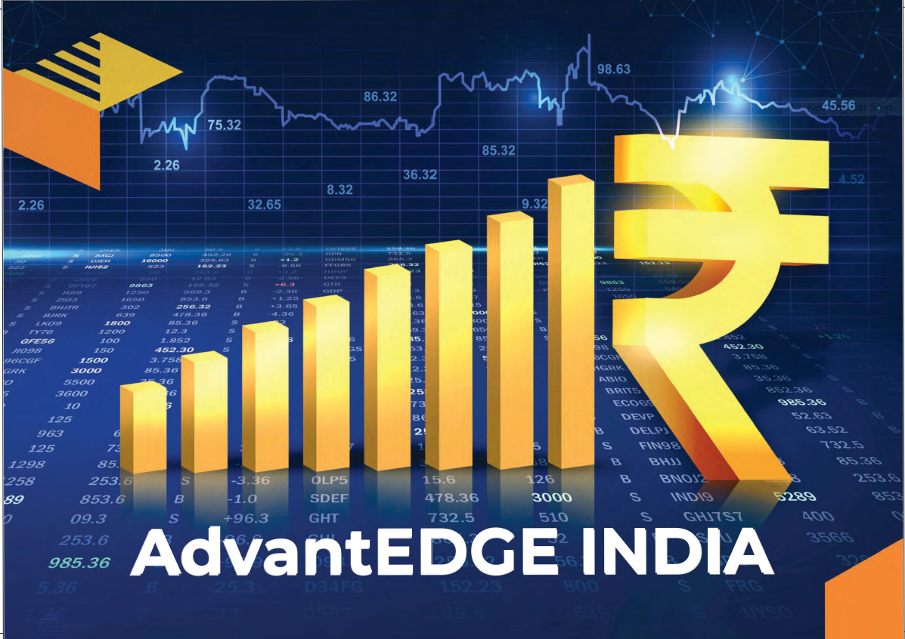
18

Slide 19
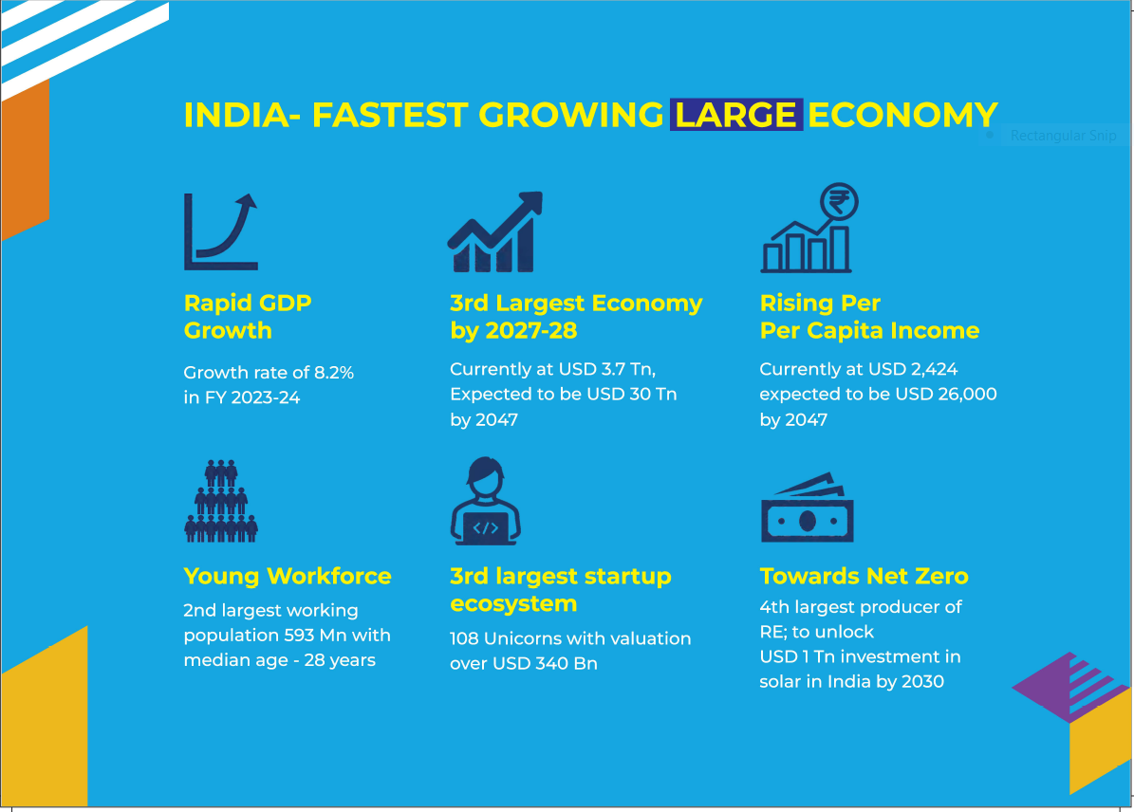
INDIA- FASTEST GROWING LARGE ECONOMY
19

Slide 20
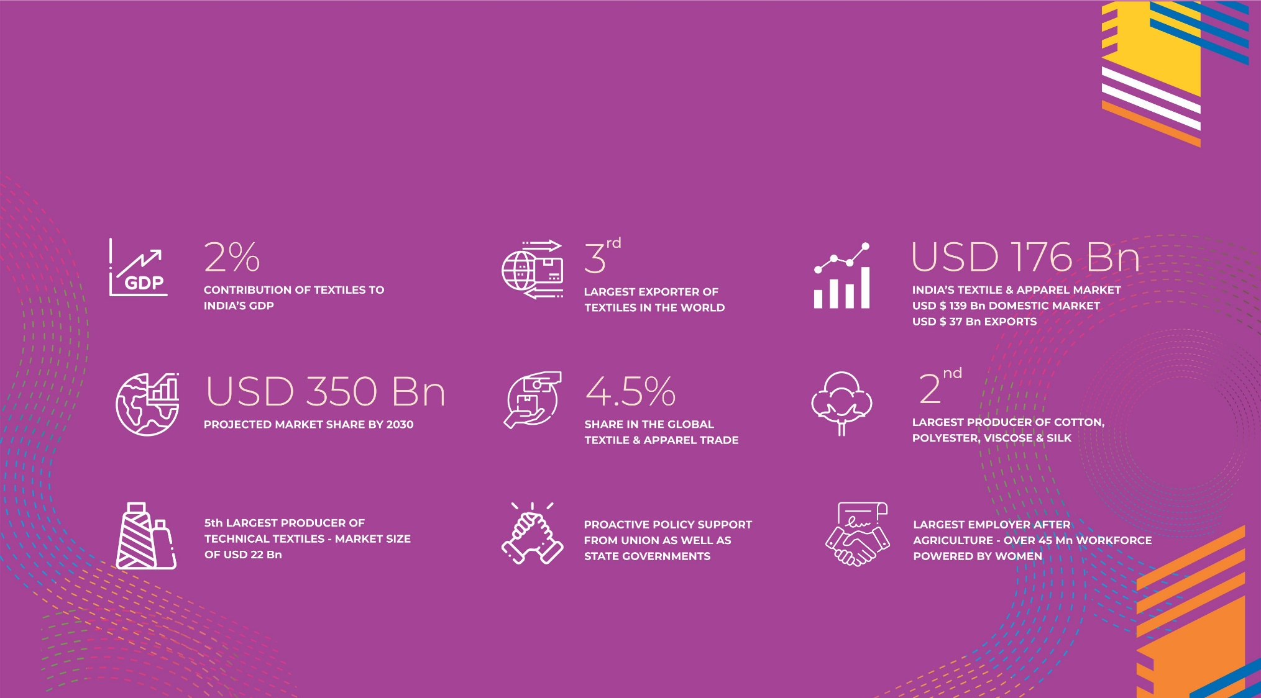
INDIA- A GLOBAL TEXTILE HUB
20

Slide 21








INDIA: A STABLE PARTNER IN AN UNCERTAIN WORLD
End to End Value Chain
Capability
Strong presence across the value chain spectrum- right from fibre to end product
Large Export Footprint
Among the largest Exporters of Textile and Apparel in the world
An Enduring Legacy
India has been a textile powerhouse for millennia. Its handlooms are valued globally.
Vibrant Domestic Market
A ~USD 140 Bn domestic market with an ~8% CAGR
Robust Raw Material Base
Abundant Raw Material Base covering
Both natural and man made fibres
Strong Policy Support
Proactive Policy Support from Union as well as State Governments
21

Slide 22






A SUPPORTIVE POLICY ECOSYSTEM
Pradhan Mantri Mega Integrated Textile Region and Apparel Parks (PM-MITRA) Scheme
Creating an integrated Textiles Value Chain
7 Mega Textile Parks with an expected investment of USD 10 Bn are being set up with world class infrastructure, plug and play facilities and an integrated ecosystem
National Technical Textiles Mission
Promoting Technical Textiles- towards USD 300 Bn by 2047
National Mission to support and promote Research, Innovation and Development, Education Training, Skill Development and Market Development in Technical Textiles
Policy Support, Incentives by the States
Liberal policy support and generous incentives by State Government including capital support, wage and skilling incentives, power and water subsidies
Production Linked Incentives (PLI) Scheme for Textiles
Boosting manufacturing of MMF Fabrics, Apparel and Technical Textiles
PLI Scheme with approved incentives of INR 10,683 crore (~USD 1 Bn) to promote production of MMF Apparel, MMF Fabrics and Technical Textiles products
Samarth
Scheme
Building Capacity, addressing skill gaps in the textile value chain
A placement oriented, industry driven skilling program across the textile value chain. In addition, various States have their own skilling/training support schemes too.

Slide 23
Mark the Dates in your Calendar
Feb 14-17, 2025
New Delhi, India
VISIT ENGAGE INVEST

Slide 24
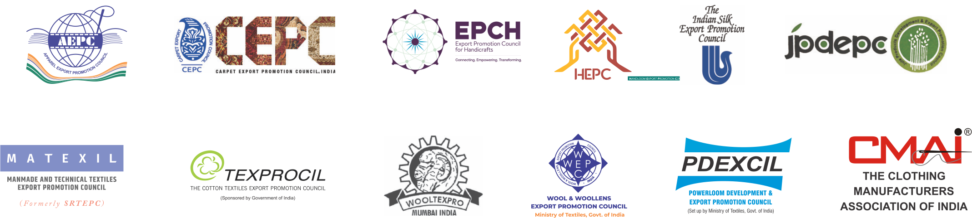
CONSORTIUM OF TEXTILE EXPORT PROMOTION COUNCILS (EPCs)
SPONSORS
PLATINUM PARTNERS
GOLD PARTNER
SILVER PARTNERS

Slide 25

25

